Slide 1
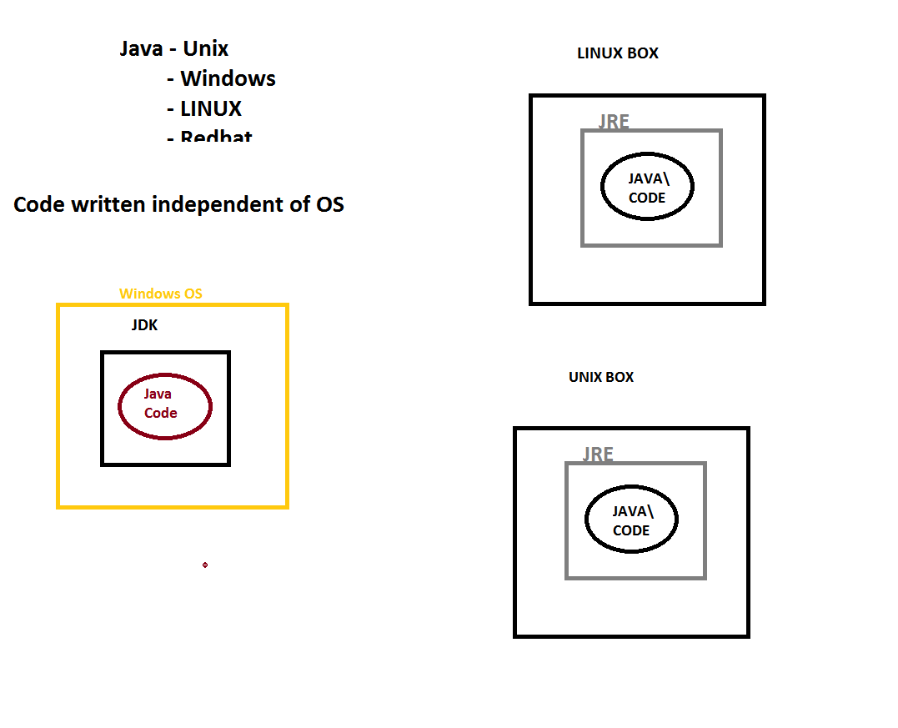
Installation

Slide 2
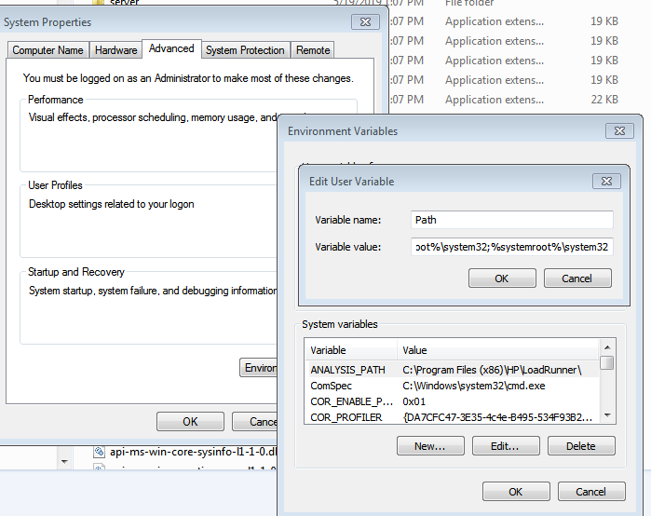
Installation
Setting up the path variable for Java 8
Install JRE (Version 8+)
https://www.oracle.com/technetwork/java/javase/downloads/jre8-downloads-2133155.html
2) Check the bin folder for jre installtion
C:\Program Files\Java\jre1.8.0_211\bin
3) Set the Env variables in system properties as shown in the picture
C:\Program Files\Java\jre1.8.0_211\bin
4) Notice bin folder should be part of it

Slide 3
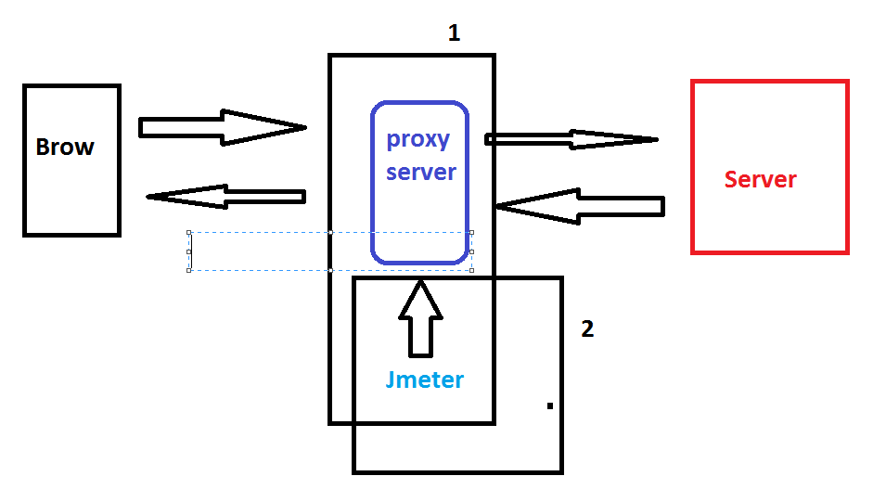
Need of Proxy Server

Slide 4
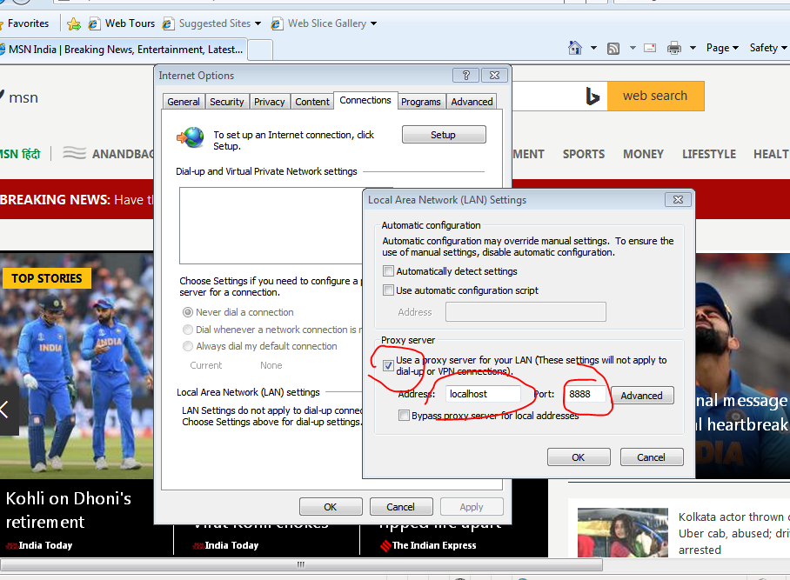
Setting up Proxy Server

Slide 5
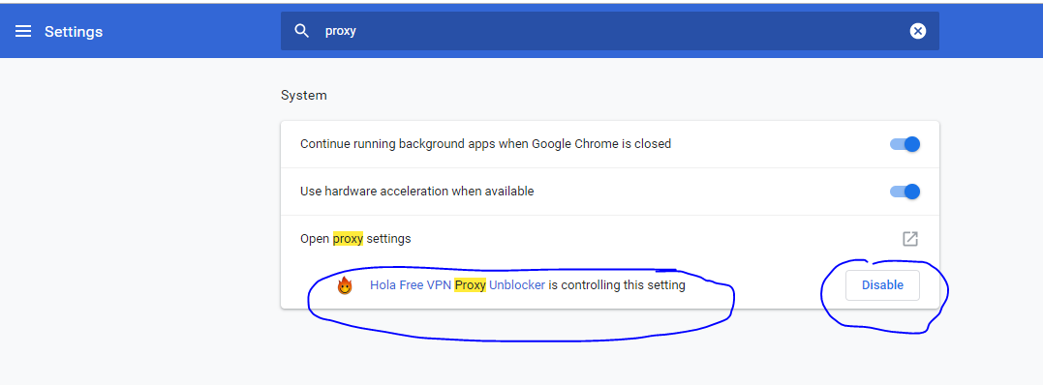
Recording Issues

Slide 6
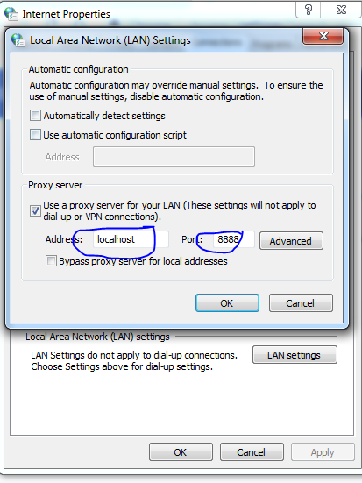
Recording Issues

Slide 7
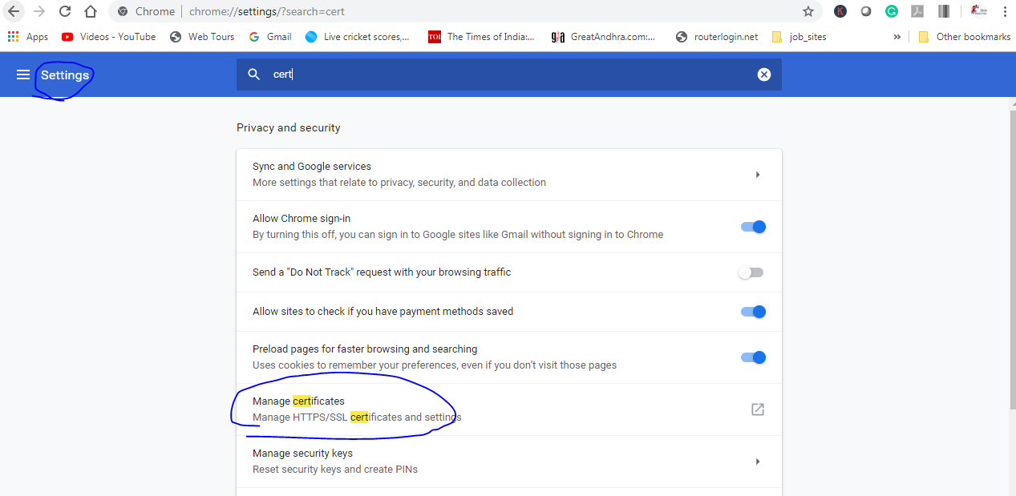
Recording Issues

Slide 8
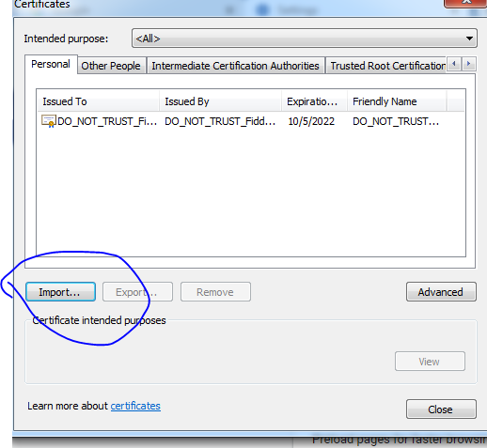
Recording Issues

Slide 9
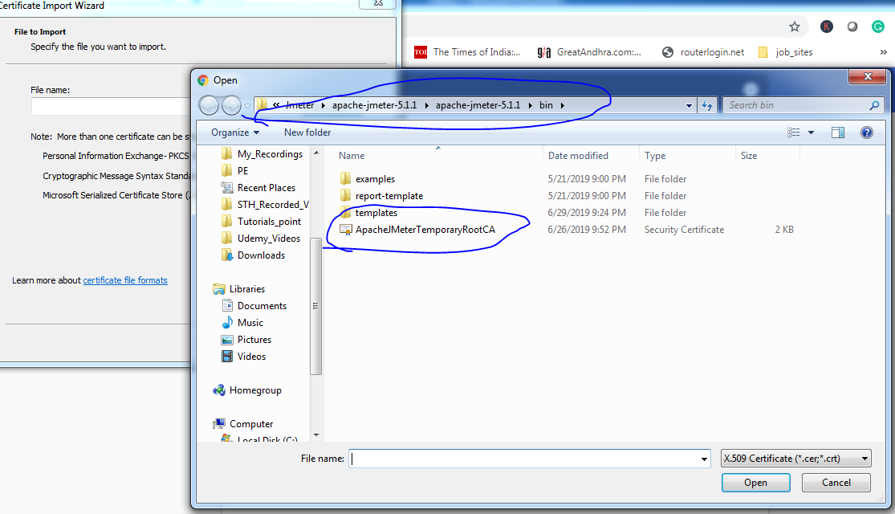
Recording Issues

Slide 10
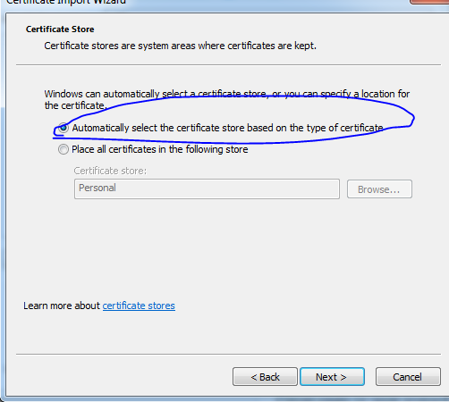
Recording Issues

Slide 11
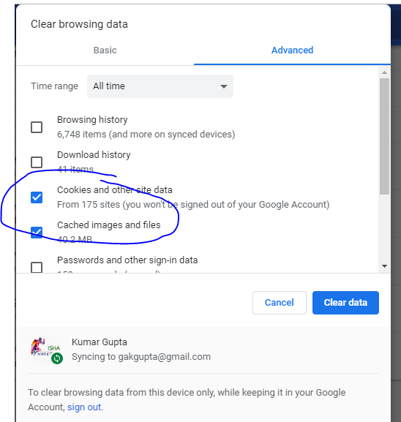
Recording Issues

Slide 12
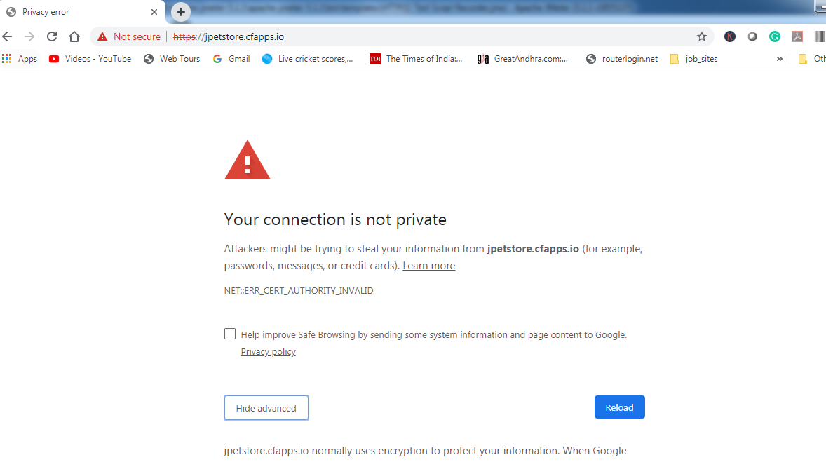
Recording Issues

Slide 13
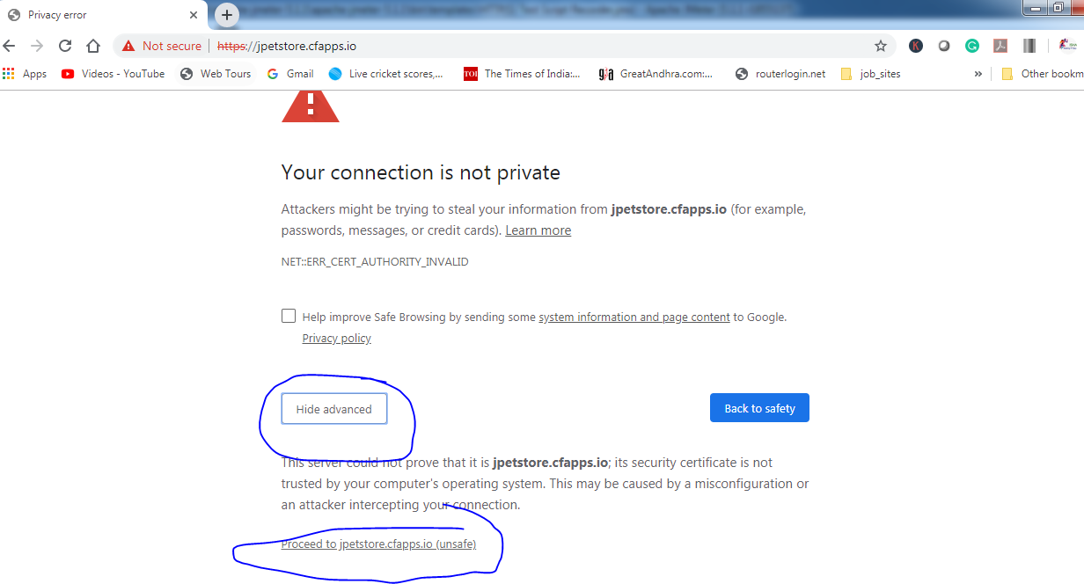
Recording Issues

Slide 14
Demo Application
http://demo.kieker-monitoring.net/jpetstore/actions/Catalog.action
A quick overview

Slide 15
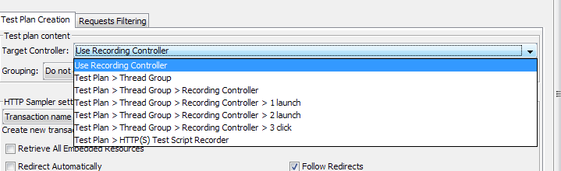
Demonstration of Recording
Record directly in “HTTP(S) Test Script Recorder”.
In “Recording controller”
Advantage of doing it Recording controller
Transfer the samplers to simple controller
Directly recording in Simple recorder

Slide 16
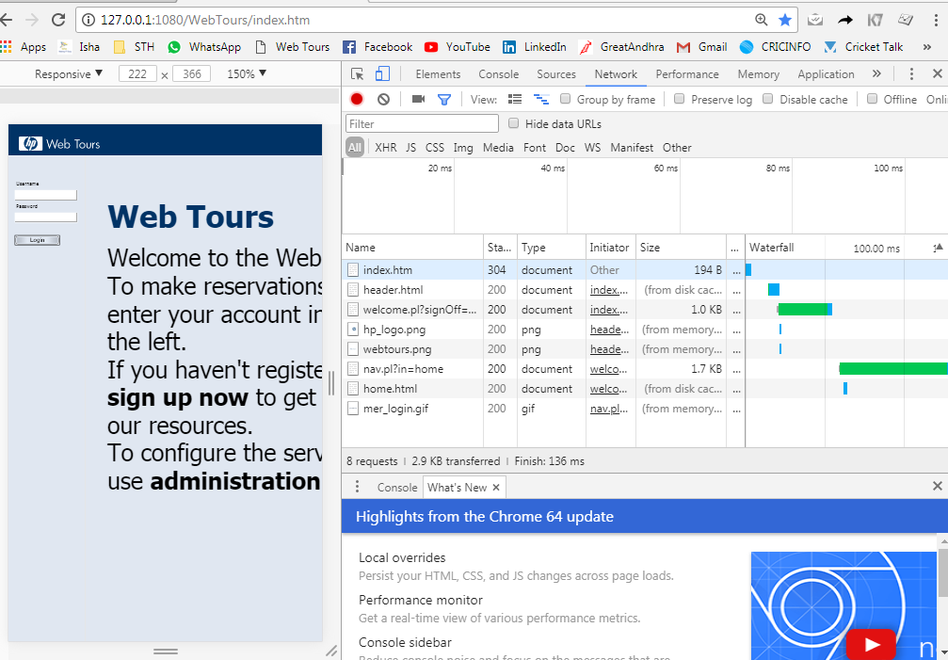
Understanding the resources associated with a request
Use Developer Tools or HTTP Watch

Slide 17

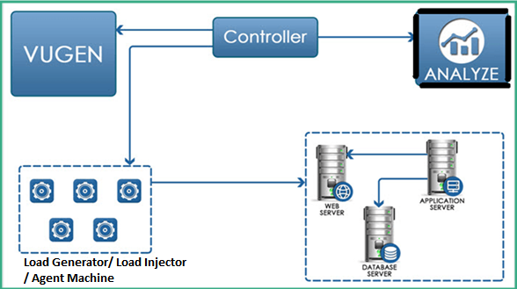
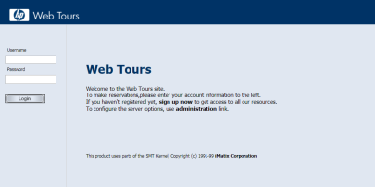
Understanding the embedded resources associated with a request
http://127.0.0.1:1080/WebTours/index.htm
Index.htm
Header.html
welcome.pl?signOff=true
nav.pl?in=home
Client
home.html
Response for Index.htm
Server
Response for Header.html
Response for welcome.pl?signOff=true
Response for nav.pl?in=home
Response for home.html

Slide 18
Understanding the Log
Listeners → View Results tree
By Default, the log will not be saved. As soon as you close the jmeter, this log disappears
This log is more like Snapshot view of Loadrunner
This holds significant value for understanding request and response for each sampler and also for doing some important enhancement like correlation.
For saving it for future use, you can save the log.

Slide 19
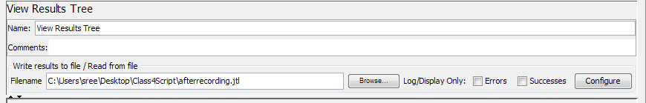
Understanding the Log
Log can be saved in 3 formats
.jtl (Jmeter Text Logs)
.csv
.xml
Filename of the log should be given prior to recording. Otherwise, log will not be saved.

Slide 20
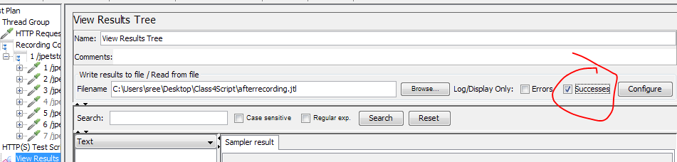
Understanding the Log
If you want to capture the log of only successful samplers, then mark the “successes” checkbox.

Slide 21
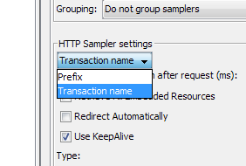
Explore options in “HTTP(S) Test Script Recorder”
Prefix and Transaction name

Slide 22
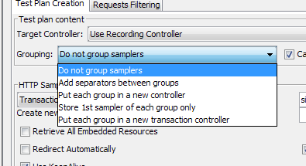
Explore options in “HTTP(S) Test Script Recorder”
Grouping

Slide 23
Transaction controller
Transaction controller merges RT of all the samplers under it
The Transaction Controller is considered successful only if all the samplers under it are successful

Slide 24
Importance of “Naming Policy”

Slide 25
How To Properly Handle Embedded Resources in HTML Responses
https://www.blazemeter.com/blog/web-testing-jmeter-how-properly-handle-embedded-resources-html-responses/

Slide 26
Recording - Different ways
Using “HTTP(S) Test Script Recorder”
Using Bad Boy – No proxy Required
Bad Boy Download Links (Version 2.2)
https://badboy1.software.informer.com/download/#downloading
https://drive.google.com/file/d/1DB0prNuPGfWLbPCytM31CiWHtEiCiUa0/view?usp=sharing
Using Blazemeter – Chrome Plug-in - No proxy Required
Using HAR file – Popular one and can be asked in interviews - No proxy Required
Using Fiddler - No Proxy is required

Slide 27
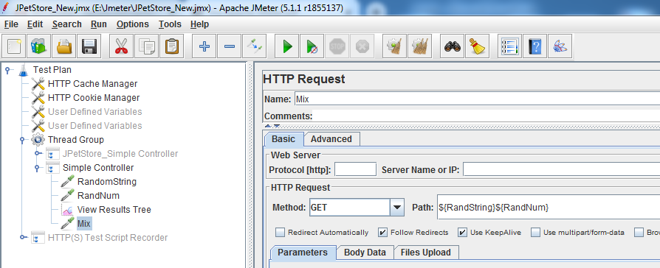
Executing in GUI Mode
Start: Start a test on the local machine
Stop: Abruptly stop the test that is running on the local machine
Shutdown: Stop the test gracefully, allowing the threads / Vusers to wind down

Slide 28
Executing in GUI Mode
Importance of Listeners → View results in the tree
Without listeners, we cannot monitor the execution
Aggregate report, Summary Report and View results in the table
All the embedded resources will be downloaded . Demonstrate the same
How clear cache works ?- Demonstrate

Slide 29
Where to look for results?
Using listeners

Slide 30
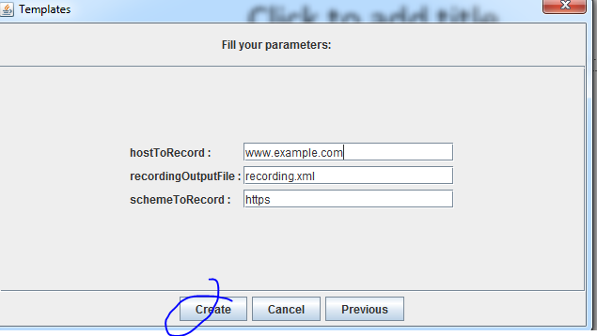
Use Recording Template

Slide 31
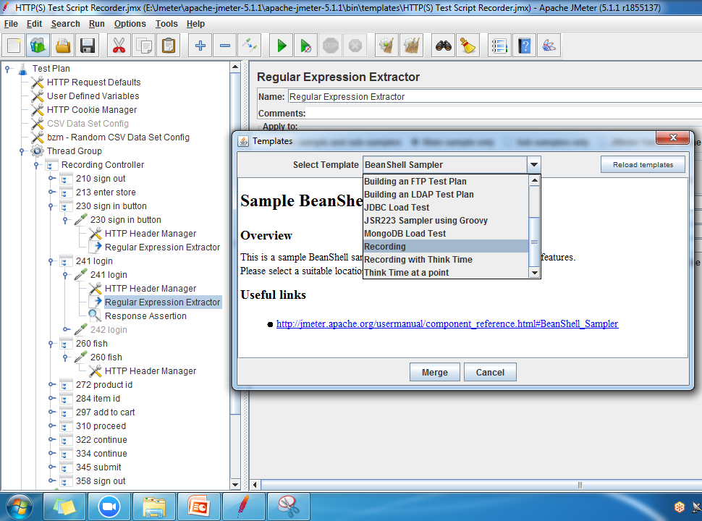
Use Recording Template

Slide 32
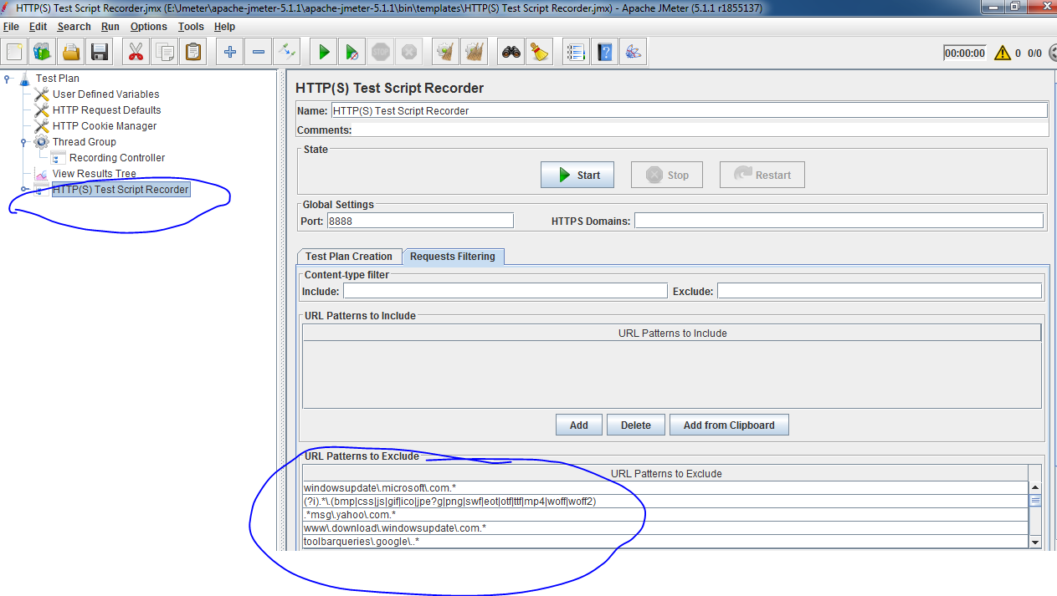
Use Recording Template

Slide 33
Executing in Non-GUI Mode
GUI mode is not desirable because:
It consumes a large amount of resources, thus interfering with the test results
To avoid these issues, use the non-GUI mode
.
To see the command line options provided by JMeter, issue the following command in the CMD prompt.
jmeter –help
C:\>jmeter -n -t FirstTestPlan.jmx -l test-run.jtl
Note that test-run.jtl is the test execution log file.

Slide 34
Non-GUI Mode
Running JMeter in command line mode:
Running JMeter using command line in non-GUI mode is very simple.
Open command prompt
Go into JMeter’s bin folder
Enter following command, jmeter -n –t test.jmx -l testresults.jtl

Slide 35
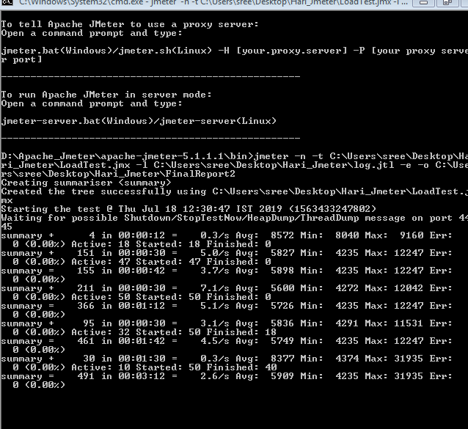
Non-GUI Mode
Screenshot is taken while the test is executing

Slide 36
Non-GUI Mode
jmeter -n –t test.jmx -l testresults.jtl
-n: It specifies JMeter is to run in non-gui mode -t: Name of JMX file that contains the Test Plan -l: Name of JTL(JMeter text logs) file to log results -j: Name of JMeter run log file
Other than these options, JMeter has several other parameters that can be used for running in the non-GUI mode.
-R: list of remote servers,
-H: proxy server hostname or ip address -P: proxy server port

Slide 37
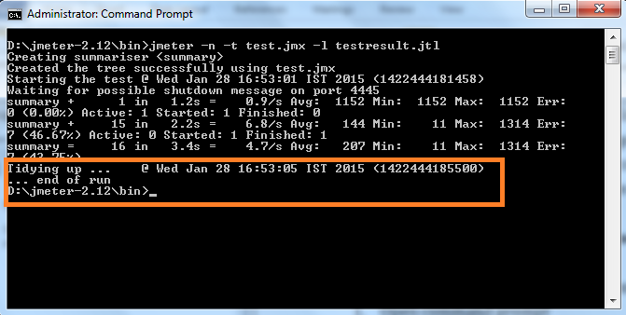
Non-GUI Mode
View test result: Once your test is complete, you will see the following display

Slide 38
Non-GUI Mode
View test result: After completing the test, a JTL file will be generated at jmeter2.12/bin folder
Follow below steps to view test results from the resultant JTL file.
Open JMeter in GUI mode.
Add any listener Eg. View Results Tree.
Click Browse button of the file name field in listener.
Open testresult.jtl file.
You should be able to see the result in listener now.

Slide 39
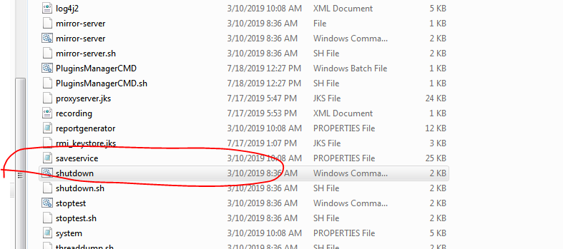
Non-GUI Mode
To stop the test
Go to the bin folder and run the following program as shown in screenshot

Slide 40
Simple Controller
The Simple Controller provides no functionality beyond that of grouping, primarily to organize samplers and other logic controllers.

Slide 41
Transaction controller
Transaction controller merges RT of all the samplers under it
The Transaction Controller is considered successful only if all the samplers under it are successful
The Transaction Controller can function in Parent Mode.
In the Parent Mode, the individual samples can still appear in the View Results Tree, but no longer appear as separate entries in View Results in Table or in other listeners.
By default, Transaction Controller does not include the time taken by timers and pre-processors.
However, it can be configured to include the timers by enabling a checkbox.

Slide 42
Transaction controller
Transaction controller merges RT of all the samplers under it
The Transaction Controller is considered successful only if all the samplers under it are successful
The Transaction Controller can function in Parent Mode.
In the Parent Mode, the individual samples can still appear in the View Results Tree, but no longer appear as separate entries in View Results in Table or in other listeners.
By default, Transaction Controller does not include the time taken by timers and pre-processors.
However, it can be configured to include the timers by enabling a checkbox.

Slide 43
Loop controller
The Loop Controller can be configured to loop indefinitely by enabling the Forever checkbox.
This gets enabled even if you enter any negative number for Loop Count.
If you run the test with the Forever checkbox enabled, you need to click on the Shutdown button and terminate the test gracefully.
Clicking on the Stop button terminates the threads abruptly, and you may see some errors in the requests.

Slide 44
Runtime Controller
The Runtime Controller controls the duration for which its child elements are run.
A Runtime Controller executes its child elements in its hierarchy for the specified duration. At the end of the nested elements, it loops through again.
Using the same logic, if the specified time runs out, the Runtime Controller stops execution even if it has executed only a part of the nested elements. The currently executing element is allowed to complete, but the newer elements are not executed once the specified time is over.

Slide 45
Throughput Controller
The Throughput Controller controls the number of executions of its child elements. This is a misnomer, as it does not control the throughput.
You can configure this in two modes:
Number of Executions: The child elements are executed until the specified count is reached and the subsequent executions are skipped. To configure this, choose Total Executions and specify a value for Throughput.
Percentage of Executions: The concept is the same except that the number of executions of the child elements is restricted by the percentage configured.

Slide 46
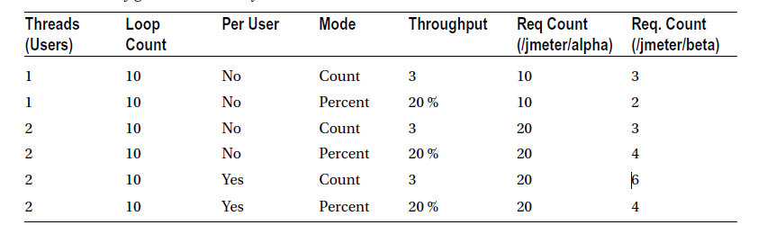

Slide 47
Once Only Controller
Once Only Controller executes its child elements only once per thread / VUser.
This is typically used to perform logins or another use-case that’s needed only once for a user session.
The Once Only Controller should be a child element of the thread group or Loop Controller. Otherwise, the behavior is not defined.

Slide 48
Interleave Controller
The Interleave Controller executes only one of its child elements per loop iteration. Each time it iterates, it picks the next child element in sequence.
How the values will be picked for multiple threads?
What if, there are child controllers

Slide 49
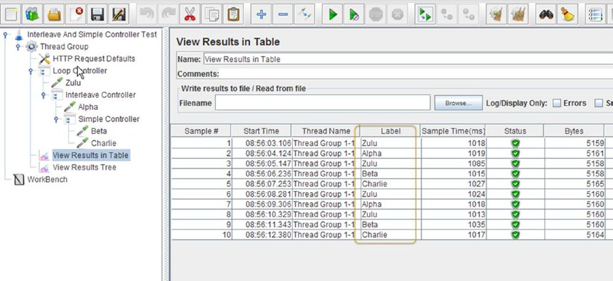
Interleave Controller
What if, there are child controllers

Slide 50
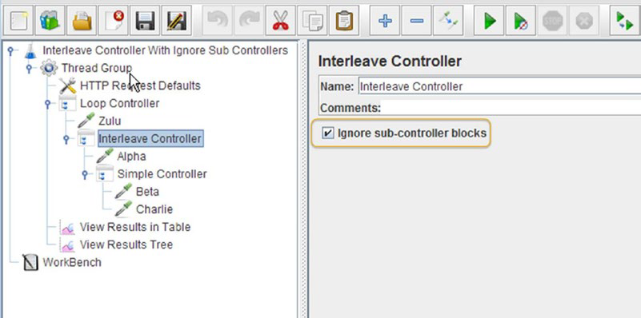
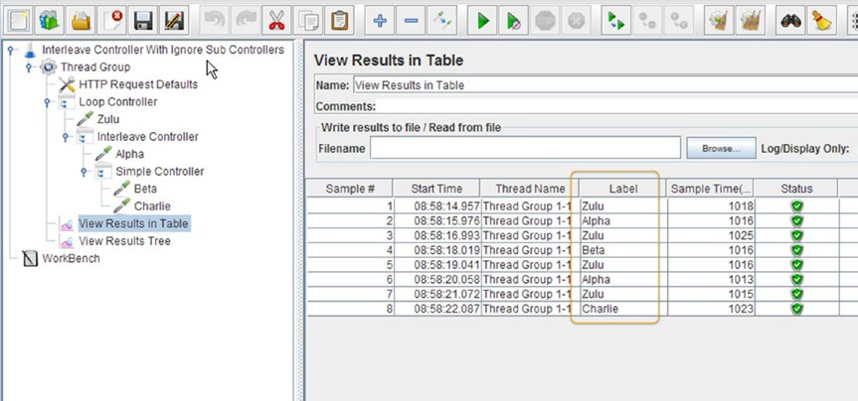
Interleave Controller

Slide 51
Random Controller
The Random Controller is similar to the Interleave Controller except that the order of interleaving is random instead of sequential. The configuration is just like the Interleave Controller.

Slide 52
Random Order Controller
The Random Order Controller executes all its Child Elements but in random order.
Random Controller executes only one of the Child Elements

Slide 53
Switch Controller
The Switch Controller is analogous to the switch/case programming construct.
The Switch Controller executes only one of its child elements after matching the element’s name with the configured Switch value.
If the Switch value is an integer, it executes the child element based on the sequence number.

Slide 54
Plug –in Manager
How to install Plug-in Manager
Need for installing plug-in manager
Install Dummy Sampler

Slide 55
User Defined Variables
In LR, we have different data types
In Jmeter we have only one → User Defined Variables
Variables Defined in “User Defined Variables” are global
Variables can be used with Jmeter Functions.
Like url→ variable
Why is it used
Where it is used
Other places that we use variables like username and password.

Slide 56
User Defined variables
Demonstrate _Random Function
Demonstrate how _Random function can be used for Credit card and other places
Random can also be created using Random Sampler.
Demonstrate Switch controller with _Random Function
Explore other Jmeter functions like _RandomDate

Slide 57
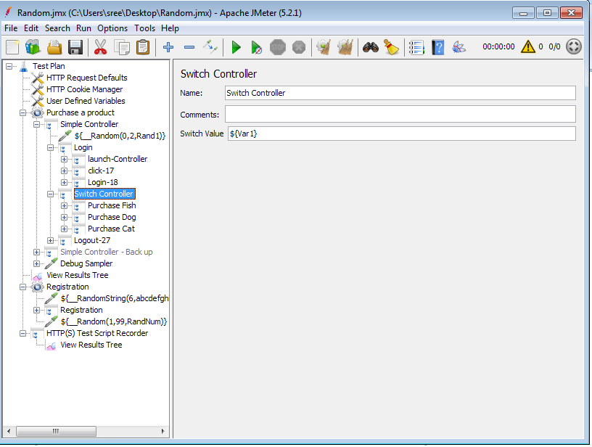
Switch Controller

Slide 58
If Controller
The If Controller is useful for decision/branching logic. The configuration is simple, with only two checkboxes.
The Evaluate for All Children checkbox indicates whether the condition should be evaluated before processing each of the child elements. If it’s not checked, the condition is evaluated only when it is encountered for the first time.

Slide 59
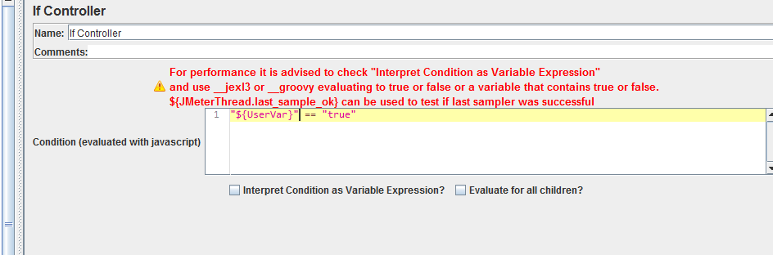
If Controller
"${UserVar}" == “true“
${Count} == 10
${Count} == 10 && "${UserVar}" == “true“

Slide 60
If Controller
A better option (default one) is to check Interpret Condition as Variable Expression?
Then in the condition field you have 2 options:
Option 1 : Use a function (${__jexl3()} is advised) to evaluate an expression that must return true or false
Use ${__jexl3()} function
${__jexl3("${UserVar}" == "true")}
${__groovy("${UserVar}" == "true")}

Slide 61
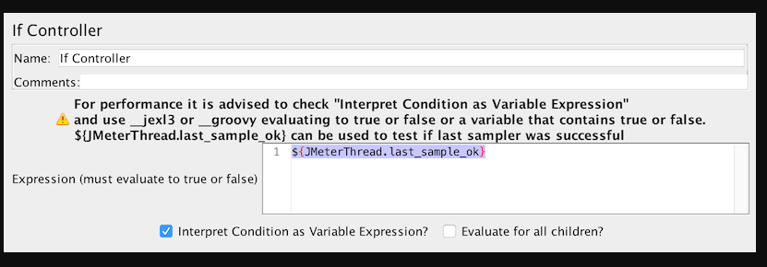
If Controller
Option 2 : Use a variable that contains true or false

Slide 62
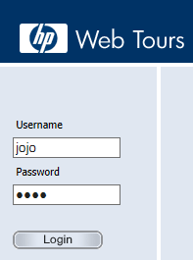


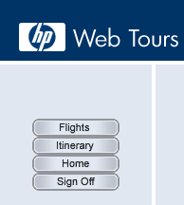
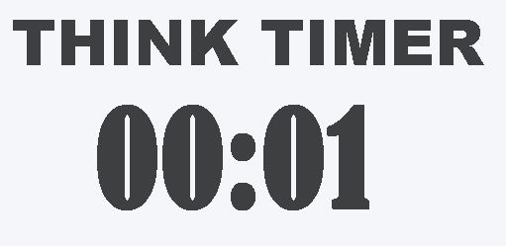
Think Time
Think time is the time that a user waits between two actions, other words Mark will wait and think
between two transactions.
Lets see the example below
Here Mark entered the user name and password in HP web tours
application’s login screen.
Where to click
After the login and home page is loaded Mark is thinking to where to click, here Think timer is started.

Slide 63
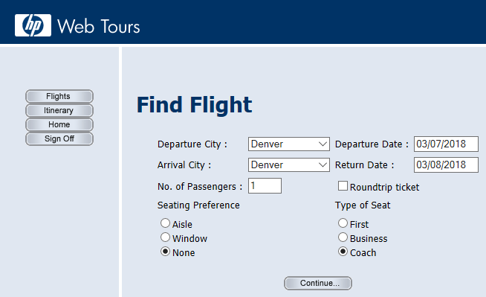
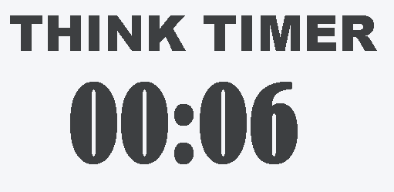
Think Time
After some time Mark decided to select “flight” button , he clicked on “Flights”. So the
the moment he clicked on flights option think timer stopped.
This Time which he spends not doing anything on the system is called “Think Time”
6 seconds is the think time for between above two transactions.
Note : Thinktime may change from user to user for the same application
10 seconds is the industry standard think time

Slide 64

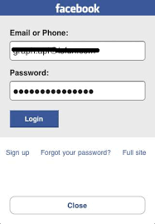
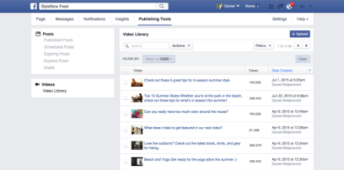
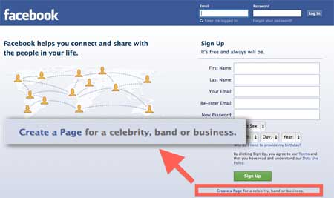
Difference between ThinkTime and Transaction Response Time
www.facebook.com
2 Secs
Client
2.5 Secs
Web Server
App Server
DB Server
Now Mark is “Thinking” as to how to login and where should he enter the username and password.
Think Time also includes time taken to enter the username / password and click on “login” button
10 Secs
7 Secs
2 Secs
2.5 Secs
Think Time
Think Time
Launch Transaction
Login Transaction
Log off Transaction

Slide 65
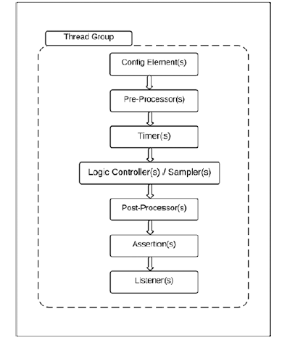
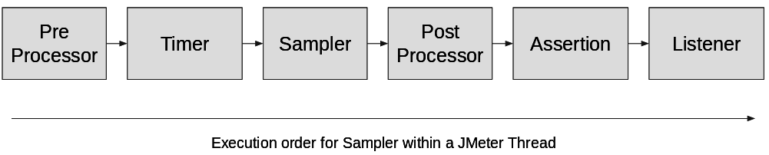
Order of Component Execution / Hierarchy
a + b * c
b*c is evaluated first and then the addition operation

Slide 66
Constant Timer
The Constant Timer introduces a specified delay before the samplers in its scope are executed. The only configuration is the delay that is needed.
Constant Timer delays all the child elements in scope.
What if you wanted to delay only a specific sampler by 5 seconds?
You can achieve this by making the Constant Timer a child element of the sampler to be delayed.

Slide 67
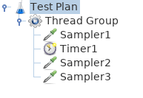
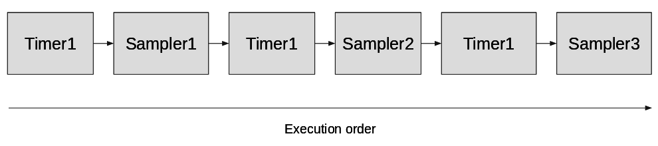
How Timers scope works
Rule 1: Timers are executed before each sampler in their scope. Constant Timer delays all the child elements in scope.
As we can see, Timer1 is:
• Executed three times because of scoping rule
• Executed once before Sampler1
• Executed once before Sampler2
• Executed once before Sampler3
Will be executed in this order

Slide 68
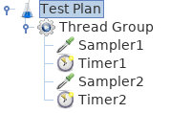
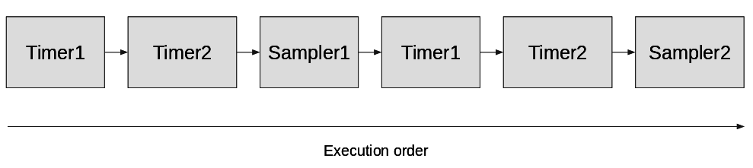
How Timers scope works
Rule 2: If there is more than one timer in the scope, all the timers will be processed before the sampler.
As we can see, Timer1 and Timer2 are:
• Grouped because all timers in scope are executed before every sampler
• Executed twice because they are applied to every sampler in scope
• Executed once before Sampler1
• Executed once before Sampler2
Will be executed in this order

Slide 69
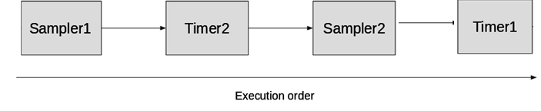
Control the execution order of Timers
If we want to have this execution order.

Slide 70


Control the execution order of Timers
Option 1. We can use Add Think Times to children feature
This feature allows us to have different think times for each element.

Slide 71

Control the execution order of Timers
Option 2: You can achieve this by making the Constant Timer a child element of the sampler to be delayed.
Nesting timers as children of samplers is less readable since timers are executed before Sampler

Slide 72

Control the execution order of Timers
Option 3: Have a random timer and put it at the same level as Sampler, thanks to scoping rules, it would run before each Sampler.
But still timers are executed before Sampler

Slide 73

More clarity on Order of Component Execution
For the given test plan, the execution order will be:
1. BeanShell Pre-processor
2. Constant Timer
3. Constant Throughput Timer
4.BSF Sampler
5. Transaction Controller
6. CSV Data Set Config
7. HTTP Request
8. BeanShell PostProcessor
9. Aggregate Report
As you can see in the screenshot below, the position of different elements does not
impact the execution order.

Slide 74

More clarity on Order of Component Execution
For the given test plan, the execution order will be:
Timer1
Timer2
JR1
Outer Postprocessor
Inner Postprocessor 1
Timer1
Timer2
JR2
Outer Postprocessor
Inner Postprocessor 2
The second rule is that outer elements are executed before inner elements of the same
Type.

Slide 75


Gaussian Random Timer
The Gaussian Random Timer introduces a delay according to the Gaussian Distribution
The delay varies around a central mean, as illustrated in Figure

Slide 76

Gaussian Random Timer

Slide 77
Gaussian Random Timer
Let’s assume that the mean value is 10 seconds and the variance is 2 seconds. The delay introduced would vary as follows:
68% of the time, the delay would vary between mean - variance and mean + variance (between 8 seconds and 12 seconds).
95% of the time, the delay would vary between mean - 2 * variance and mean + 2 *variance (between 6 seconds and 14 seconds).
99% of the time, the delay would vary between mean - 3 * variance and mean + 3 *variance (between 4 seconds and 16 seconds).
Use Loop controller to demonstrate the Gaussian delays

Slide 78
Uniform Random Timer
The delay introduced by the Uniform Random Timer has two parts:
Constant Delay: Fixed and equal to the configured value.
Random Delay: Varies between zero and the configured value.
The actual delay will range between the Constant Delay and the Constant Delay plus the Random Delay.
As the term “uniform” indicates, the delay varies within its range with equal probability.
If the Constant Delay was configured to 10 seconds and the Random Delay was configured to 5 seconds, then the actual delay will vary between 10 and 15 seconds.
Use Loop controller to demonstrate the Gaussian delays

Slide 79

Uniform Random Timer

Slide 80

Combination of both URT and Gaussian Is used in Real World
Notice, GRT is not added for 1st sampler, as timer is executed before the sampler

Slide 81

Constant Throughput Timer
The Constant Throughput Timer calculates and introduces delays between samplers so as to keep the throughput at the configured value.
Target throughput(in samples per min) = 5
Configure Number of Threads (Users) as 1 and Loop Count as 20.
In these results, each of the requests to /jmeter/alpha has been delayed by a varying amount so as to keep the overall throughput at the configured level
In the Aggregate results, observe that the throughput is approx 5 requests per minute.

Slide 82

Synchronizing Timer
The Synchronizing Timer blocks VUsers and releases them all at once, thus creating a large load at the same instant. This is very helpful to test how the application handles simultaneous requests.
Number of Threads (Users) as 4, Loop Count as 12

Slide 83
Assertions
The primary purpose of assertions is to validate the server response and decide if the test passed or failed.
The response to a sampler contains code to indicate success or error. But this is at the protocol level.
JMeter assertions provides a mechanism to validate the content of the response.
The specific JMeter assertions you use depend on the response format.
The validation check is configurable based on the assertions type.
JMeter assertions can be a child element of a test plan, thread group, controller, or sampler.
Assertions will apply to all the samplers under the scope of its parent. For example, if an assertion is a child element of a thread group, then it applies to all the samplers under the thread group.

Slide 84
Assertions
Sometimes, it makes more sense to have specific assertions for each sampler.
JMeter provides the flexibility to add multiple assertions.
Assertions are used to validate the test script.
The Assertion Results listener is a special listener intended specifically for viewing the results of assertions.

Slide 85
Assertions
Duration Assertion – Response time SLA verification
Size Assertion – Esp Useful for File Download
HTML Assertion – Can provide threshold for errors and warning
-Only check the format
XML Assertion – Check the format - SOAP / Restful WS
JSON Assertion – Esp useful for Restful Services or if any response is in JSON

Slide 86
How Assertions scope works
Copy from Page 89 to 90

Slide 87
How Assertions scope works
Assertions are used to validate a response.
© 2015 - 2018 Antonio Gomes Rodrigues, Philippe Mouawad and Milamber
Important concepts in JMeter 86
JMeter out of the box considers all 4xx and 5xx responses as failures
Like Timers, we have rules too.
These rules apply regardless of the location of the assertion.
Rule 1: Assertions are executed after each sampler in
their scope or to parent samplers
Example 1:
• Assertion will validate Sampler1 and Sampler2 responses
Example 1
Example 2:
• Assertion1 will validate Sampler1 response
• Assertion2 will validate Sampler2 response
© 2015 - 2018 Antonio Gomes Rodrigues, Philippe Mouawad and Milamber
Important concepts in JMeter 87
Example 2
Example 3:
• Assertion1 will validate Sampler1 response
• Assertion2 will validate Sampler1 and Sampler2 response
Example 3
Example 4:
• Assertion1 will validate Sampler1 and Sampler2 response
© 2015 - 2018 Antonio Gomes Rodrigues, Philippe Mouawad and Milamber
Important concepts in JMeter 88
Example 4
Rule 2: Failed assertions cause the failure of the entire
Transaction Controller
Example 5:
• All samplers will be validated by assertion Assertion1
• Controller1 will be marked as failed because of Sampler2’s failure
Example 5
Rule 3: Assertions can validate main sample and/or
sub-samples
For some Assertions, we can select if we want to apply it to main sample and/or
sub-samples.
© 2015 - 2018 Antonio Gomes Rodrigues, Philippe Mouawad and Milamber
Important concepts in JMeter 89
For example, in Response Assertion.
Response Assertion apply to
Validating sub-samples can be useful when Retrieve all Embedded resources is
checked in a HTTP Request.
Example 6:
Validate Cache-Control: max-age=3600
We want to validate that all Embedded resources have a Cache-Control response
header equal to max-age=3600.
© 2015 - 2018 Antonio Gomes Rodrigues, Philippe Mouawad and Milamber
Important concepts in JMeter 90
Validation of Cache-Control failed
Rule 4: Be careful with low performing assertions
Some assertion consume a lot of resources like:
• XPath Assertion
• XML Assertion
• XML Schema Assertion
• HTML Assertion
We advise you to limit the number of assertions for these types and possibly only
use the first one - XPath Assertion - which has a real benefit.
Our advice
The easiest way to use Assertions is to add them as children of samplers.

Slide 88

JSON Assertion

Slide 89

JSON Assertion
Script Name is JSON_assertion in Desktop

Slide 90
Thread Group (need to add at last)
Every test has one or more thread groups. A thread group is a child element of a test plan. Each thread group
represents a use-case. As you will see later in the book, a thread group can be configured with the number of
threads, ramp-up time, and other useful properties that allow you to control its behavior.

Slide 91


Parameterization

Slide 92

Parameterization

Slide 93

Parameterization

Slide 94

Parameterization

Slide 95

Parameterization

Slide 96

Parameterization

Slide 97

Correlation
G1 is the first group and G2 is 2nd group.
$2$ pulls 2nd group values

Slide 98

Correlation
To demonstrate “NOTFOUND”, make sure first correlation fails, so that second correlation value is displayed as “NOTFOUND”
Infact, anything can be set as default values.
Even we can use empty value but it has benefits to use “NOTFOUND”

Slide 99

Correlation
0 for random
1 for fish
2 for dogs

Slide 100
Correlation
Capture the complete response
(?s)(.*)
?s represents new lines

Slide 101
How properties differ from variables
Properties and variables allow you to make data dynamic in JMeter. So the purpose
is very similar:
Important concepts in JMeter
• Variables are tightly bound to their thread, meaning that every thread has its
own copy and can manipulate their own version.
• Properties are shared among all threads, so changing a property during a test
should be avoided. If you really need to change it, ensure that the value is not
corrupted by simultaneous access by synchronizing this access.
In summary, variables and properties differ in that Properties are global and Variables
are local with respect to threads.
Based on this, we can define two rules:
• Properties should be used for environment-related data
• Variables should be used for user-related data and correlation rules. That’s why
for example, extractors in JMeter will create variables

Slide 102
How properties are created
Properties are created by JMeter reading them from:
• jmeter.properties
• user.properties
• command line using “-J” option: -JpropName=propValue
• command line using “-G” option: -GpropName=propValue
• any file referenced through command line option “-p” or ”–propfile”
• any file referenced through command line option “-q” or ”–addprop”
• any file passed using command line option
You can also create them from JMeter using function:
${__setProperty(propName, propValue)}
And finally, using scripting elements like JSR223 Test Elements
props.put("propName", "propValue");
or:
props.setProperty("propName", "propValue");

Slide 103
How variables are created
Variables are created by JMeter using different elements:
• User Defined Variables a config element
• User Parameters a pre-processor
• JMeter functions⁴⁶ that accept a variable as last argument
• JMeter extractors⁴⁷ that create variables from response excerpts
You can also create using scripting elements like JSR223 Test Elements:
vars.put("varName", "varValue");
or:
vars.putObject("varName", objectToBeUsed);

Slide 104
How ${} differs from ${_P}
Since we know the difference between Variables and Properties, let’s see how to use
them.
Variables are accessed using ${varName}
Properties are accessed using __P function, so to read property propA, you
would use ${__P(propA)}

Slide 105

Remote execution – Master / Slave

Slide 106
Remote execution – Master / Slave
On both master and slave, jmeter should be available.
Get IP Address of Master and Slave.
Both Master Machine and Slave machine should be in the same network.
Master Machine → From the Jmeter Bin Folder -→ Execute “Create-rmi-keystore” windows batch file.
Enter pertinent information on the cmd prompt like firstname, lastname, state, company id etc…
Once the cmd prompt is executed, a file is created with the name “rmi-keystore.jks”

Slide 107
Remote execution – Master / Slave
Copy “rmi-keystore.jks” into the slave machine – bin folder
Master Machine – User.properties file → Copy below information.
Notice following changes to the file
“remote_hosts=127.0.0.1,192.168.1.3”
In the above
127.0.01 is the indication for master file
192.168.1.3 is the ip address of slave file

Slide 108

Remote execution – Master / Slave
Slave Machine – User.properties file → Copy the same information as done for master. <No Changes at all>
Run “jmeter-server” windows batch file – on slave machine

Slide 109
Remote execution – Master / Slave
Created Remote object in the cmd line indicates that connection is established.
Note: If you wanted to use master also, run “jmeter-server” windows batch file on master also.

Slide 110

Remote execution – Master / Slave
From the master, test can be executed with the users of the slave as shown in the above picture.
“Starting the test on the host” on the cmd line indicates, slave is used for execution.

Slide 111
Reports
Beanshell

Slide 112

Create a Test Scenario
Merge multiple scripts using Merge options

Slide 113

Create a Test Scenario
Merged 3 scripts below

Slide 114

Create a Test Scenario
Apply following settings for executing for one hour.
Here Ramp up period id 10 secs. Which means 1 user for every 2 secs
Make sure forever options is check and duration as 3600 secs
No option of ramp down.
We need a plug-ion

Slide 115
Create a Test Scenario
Make sure Aggregate Listener is added to get the response times report

Slide 116

Create a Test Scenario
Make sure Simple data writer Listener is added to get the final report

Slide 117
Test Results
For creating a report for Load Test, Some changes needs to be done in user.properties file (GUI and also non-GUIExecution)
In real world Non-GUI mode execution is preferred as it consumes less resources.

Slide 118

Test Results
Add simple data writer listener
Make following changes

Slide 119


Slide 120


Slide 121
Jmeter –g C:\Users\sree\Desktop\Jmeter_Scripts\DashboardReport.csv -o C:\Users\sree\Desktop\Jmeter_Scripts\DashboardReport
Command to generate the graphs.
Graphs can be generated via the file created by simple data writer listener

Slide 122
Jmeter Latency & Sample Time
https://performancetestersdiary.wordpress.com/2013/01/30/jmeter-latency-sample-time-and-302s/

Slide 123
Pre-Processor
Pre-processor
Client
Web App Server
DB Server
Pre-Processors
Pre-processors take the request and modify it (substitution, enhancement, dereferencing variables, etc.)
before the sampler sends it to the server.

Slide 124
Post-Processor
Post-processor
Client
Web App Server
DB Server
Post-Processors
Post-processors process the response from the server. They are used to process the server response and
modify the component settings or to update variables

Slide 125
Order of Component Execution / Hierarchy
a + b * c
b*c is evaluated first and then the addition operation

Slide 126
Order of Component Execution
For the given test plan, the execution order will be:
1. BeanShell Pre-processor
2. Constant Timer
3. Constant Throughput Timer
4. Transaction Controller
5. CSV Data Set Config
6. HTTP Request
7.BSF Sampler
8. BeanShell PostProcessor
9. Aggregate Report

